Slide 1




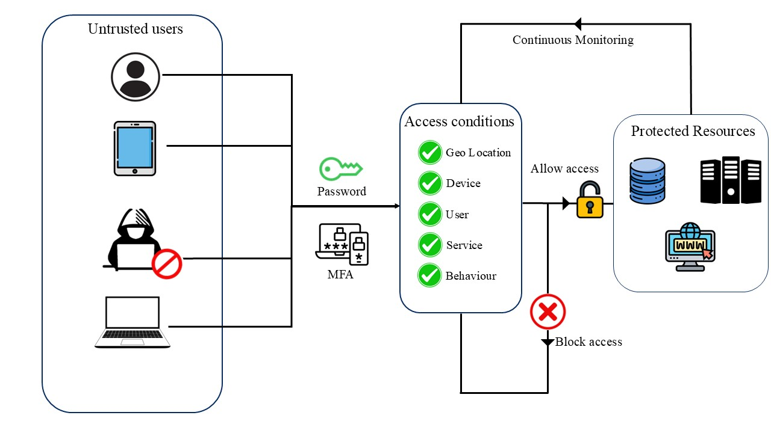
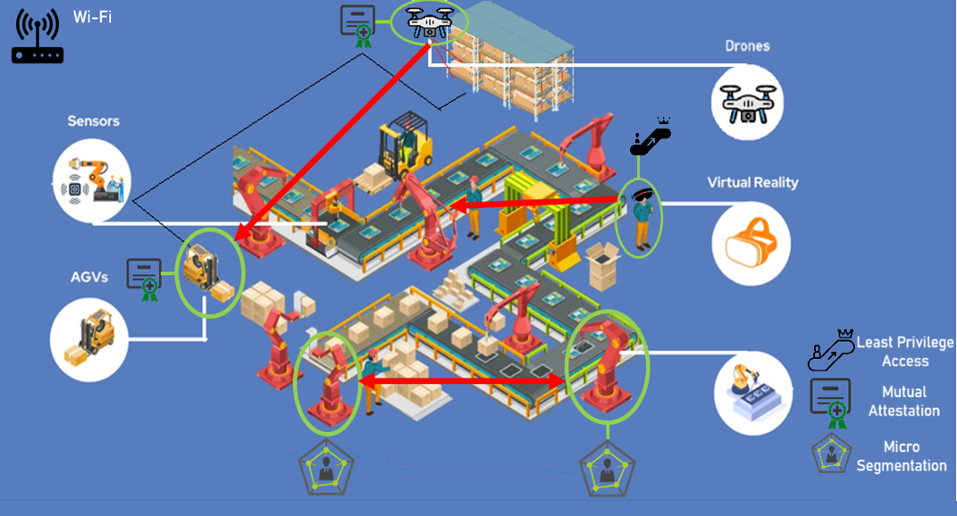
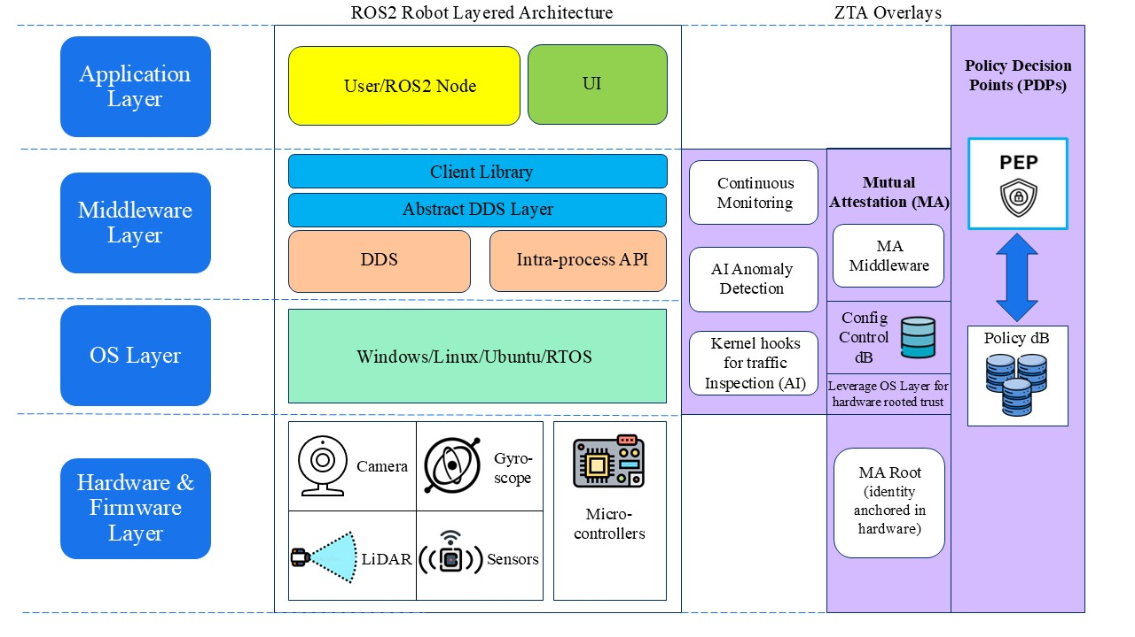


ZETAS: Zero Trust Framework for Autonomous Systems with Shared Cyber Attack Surfaces
Soham Vaidya
NTU & I²R, A*STAR
Anku Adhikari
I²R, A*STAR
Background & Aim
Interconnected autonomous systems are rapidly emerging in domains like smart factories and healthcare. These systems, which have similar layered architectures (sensing, communication, control, and interface), include robots, drones, IoT sensors, AVs, and XR technology. As a result, there is a potential of lateral movement across the components and overlapping vulnerabilities.
To address this, Zero Trust Architecture (ZTA) can be used to enhance security. However, traditional ZTA in such environments can face limitations like:
High computational and power demands.
Latency from continuous authentication and policy checks.
Centralized Policy Decision Points (PDPs), creating bottlenecks and a single point of failure.
Aim: We propose ZETAS (Zero Trust for Autonomous Systems) - a unified, Zero Trust framework tailored for autonomous systems to:
Enable low-latency real-time monitoring using lightweight AI models.
Support optimized mutual attestation.
Implement distributed PDPs to reduce latency and enhance resilience.
Threat Model
Figure 1: Zero Trust Architecture Diagram
Wi-Fi
Robots
Robots
Robots
Survey and Analysis
Types of smart factory technologies. Adapted from "Smart Manufacturing: The Future of Smart Factories", by E. Thompson, Cyngn, 2024.
Figure 2: Proposed ZETAS framework for Smart Factory application
Potential Attack | STRIDE | Impact | ZTA Defence
Command Injection from Compromised Wi-Fi → AGV | Tampering, Elevation of Privilege, Information Disclosure | Rogue navigation commands can cause collisions or data theft | Continuous Monitoring + Mutual Attestation
Spoofed Data Injection from Sensor → Robot | Spoofing, Tampering | Robots act on fake commands or manipulated sensor data | Policy Enforcement Point (PEP) + Least Privilege Access
Replay Attack from Compromised Camera → AGV | Tampering, Spoofing | Repeated actions cause inventory misplacement or redundant AGV movements | Mutual Attestation + Continuous Monitoring
Command Injection from XR Interface → Robots | Elevation of Privilege, Tampering, Repudiation | Malicious XR sends unauthorized start/stop or reprogramming commands | Micro-segmentation + Least Privilege Access + Mutual Attestation
Path Override from AGV → Robots | Tampering, Denial of Service | Factory Robot Arm follows incorrect path, risking collision or production halt | Continuous Monitoring + Policy Enforcement Point (PEP)
Methodology
Challenges
Optimizing mutual attestation by using robust trust models that reduce the number of handshakes for authentication.
Managing distributed access and storage of the policy databases for Policy Decision Points (PDP).
Designing AI pipelines that balance inference accuracy with real-time performance constraints.
Quantizing models to fit memory and compute limits of embedded edge platform.
Establishing benchmarking metrics to evaluate trust model accuracy, latency, anomaly detection rates across diverse autonomous systems and operational scenarios.
Acknowledgement
This work was partly supported by the Singapore NRF Fellowship programme (NRF-NRFF16-2024-0002).
Connect!
Figure 3: ZETAS framework overlays with ROS2 Architecture for robots
More Info!

